Slide 1

Design of website on easy farming using transformation knowledge set to farming

Slide 2
Project Overview
Objective: To create a user-friendly, resource-rich website to support immigrant and newcomer families in integrating into local farming communities.
Target Audience: Newcomer farmers with varying levels of agricultural experience and language proficiency.

Slide 3
Challenges & Solution
Seasonal Time Constraints Busy farming schedules
Created quick-view guides and summarized content for fast referencing in the field.
Low digital literacy
Simple UI and icons
Diverse climate & soil conditions
Region-based filters and maps

Slide 4
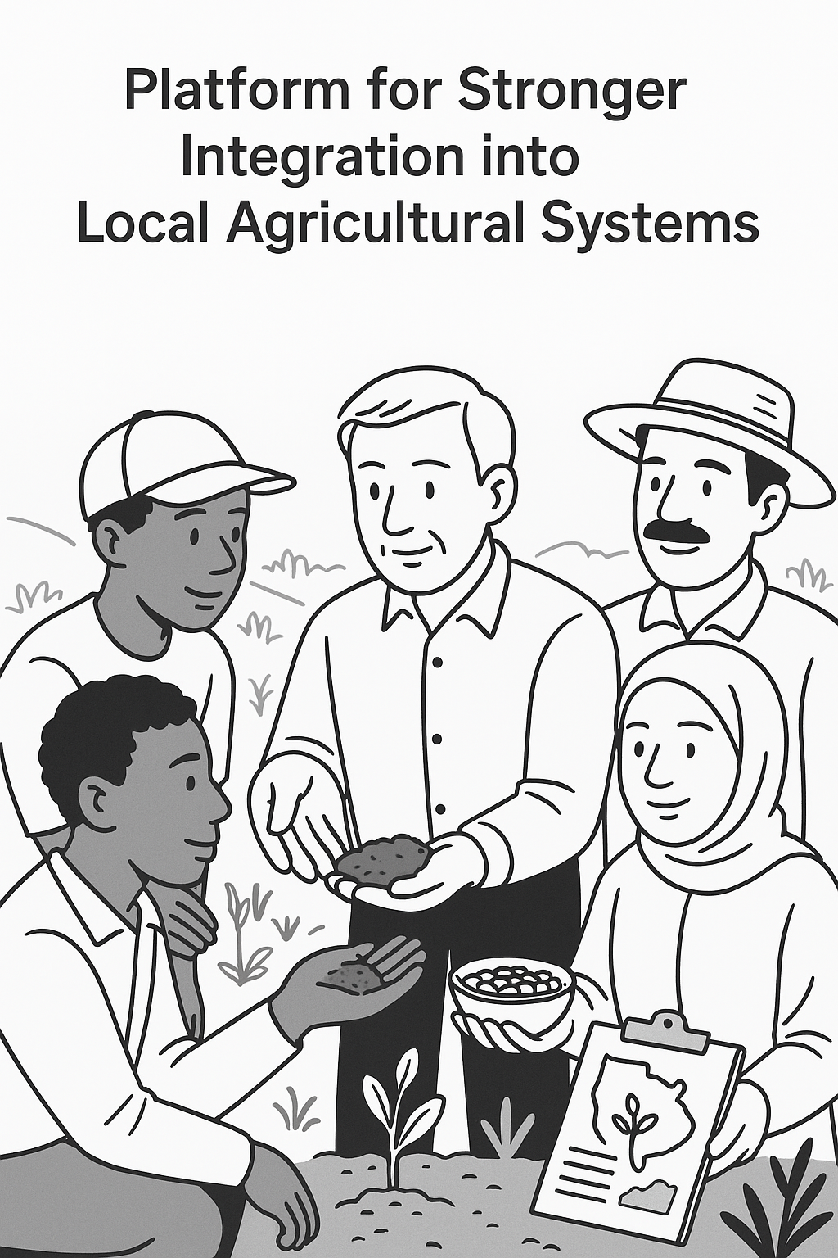
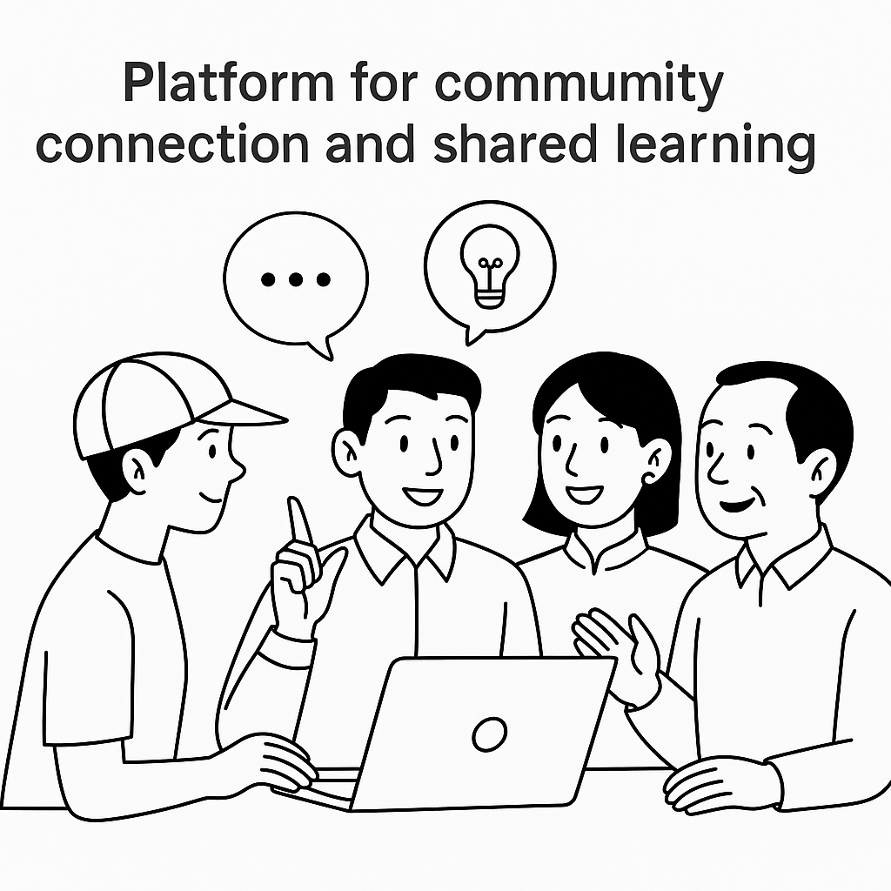
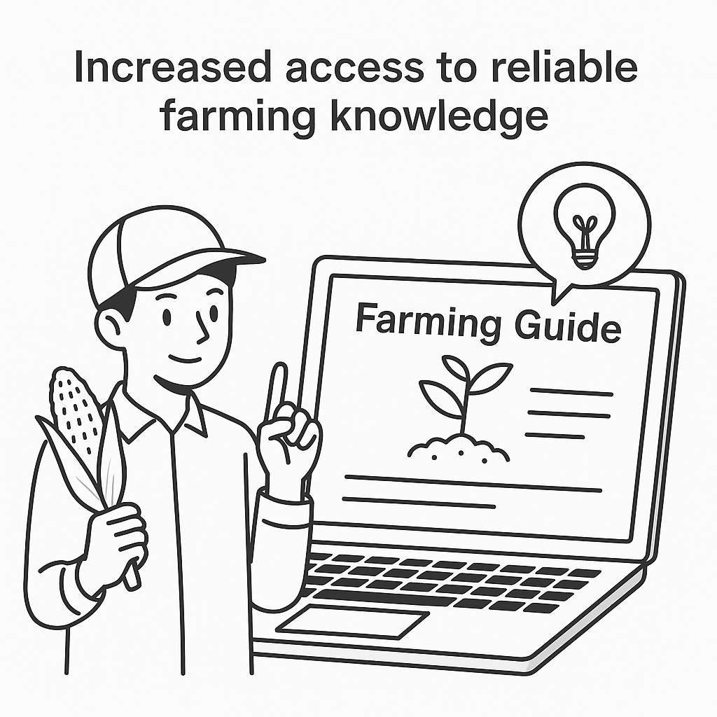
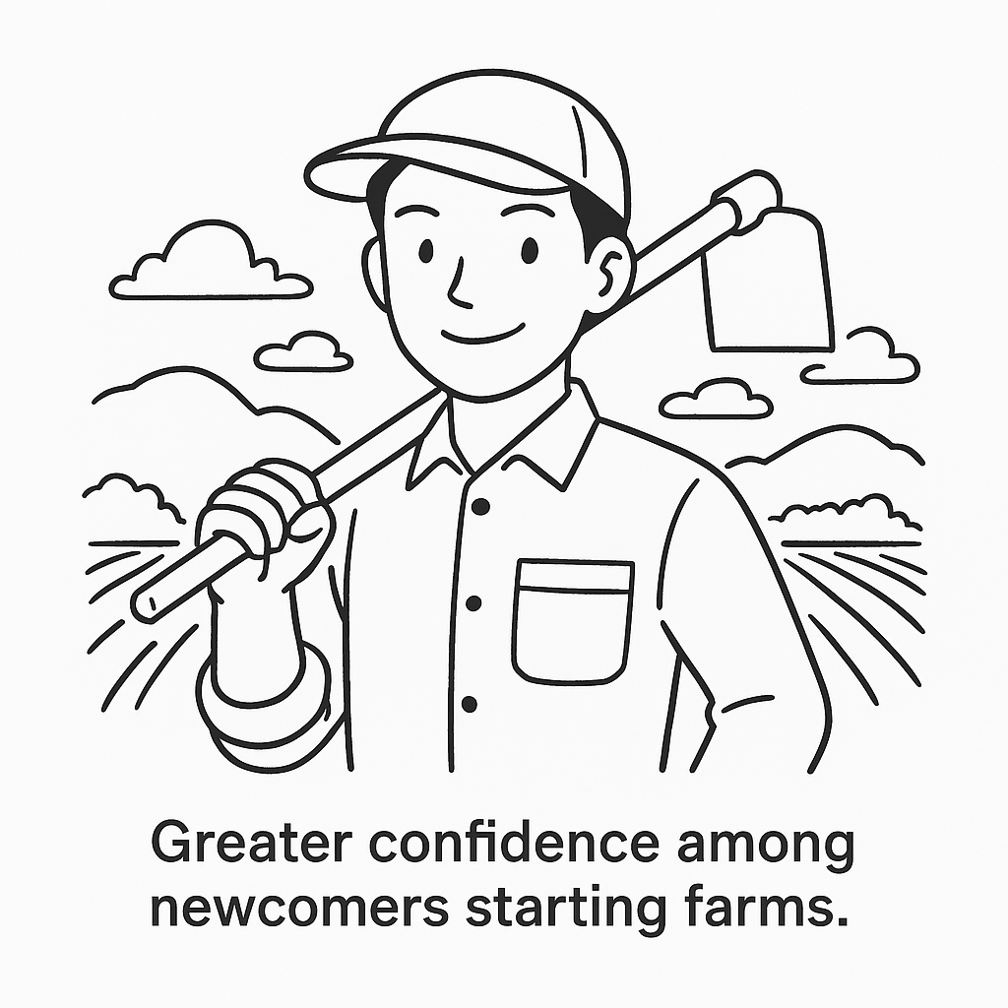
Outcomes & Impact

Slide 5
Sustainability & Future Growth
Eco-Friendly Practices:
Growth Opportunities
Long-term plans to integrate additional features such as crop rotation advice, permaculture practices, and organic certification information
Focus on sustainable farming methods to preserve the environment.
Guides on organic farming, water conservation, and eco-friendly pest control.
Expansion to support farmers in other regions and countries.

Slide 6
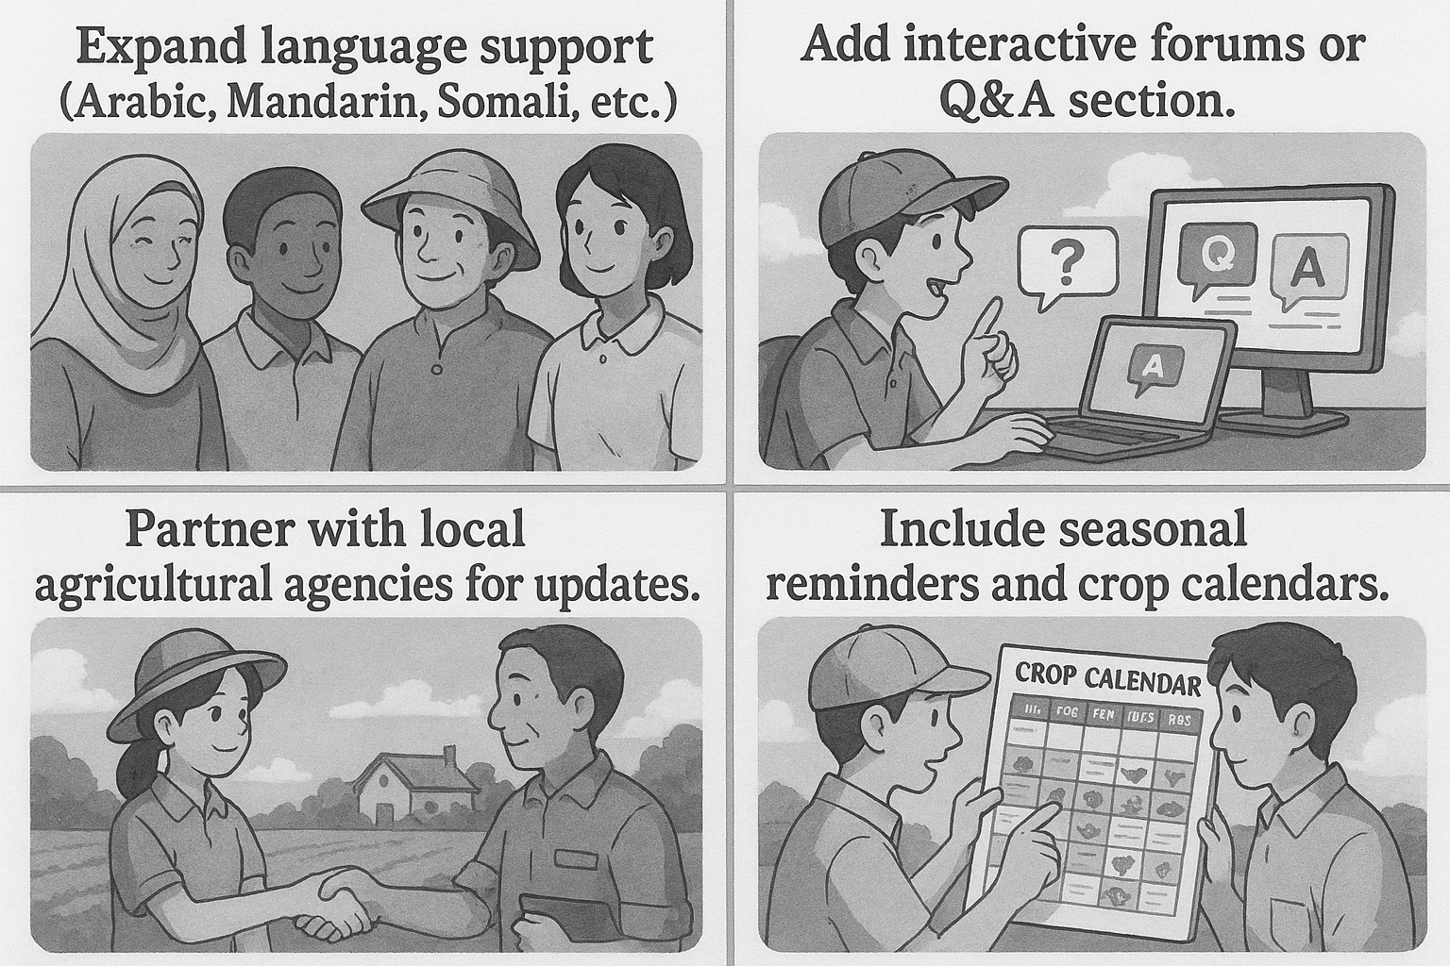
Future Improvement

Slide 7
User testing & feedback
1.Conducted with newcomer farmers and support workers.
2.Positive feedback on simplicity, clarity, and usefulness.
3.Suggestions implemented:
Added multilingual video support.
Improved navigation icons.
Included more region-specific crop suggestions.

Slide 8
Local Partnerships
Collaboration with agricultural extension services, local farmers, and government programs to provide timely resources.
Community Engagement & Support
In the future, integrating with local markets for crop sales advice and connections.

Slide 9
Development process
Content Integration & Testing
Wireframing & Content Planning
Final Review
1
5
1
2
4
5
6
2
3
4
6
Research & User Needs Assessment
Design & Frontend Development
Feedback Implementation

Slide 10
User
engagement
Impact
Number of crops successfully grown based on website recommendations.
Testimonials from users about how the website has helped them start or improve their farms.
Partnerships formed with local farming organizations and cooperatives.
Current user statistics (monthly active users, session time, user feedback).
Increased awareness of sustainable farming practices among users.

Slide 11
Partnerships
Building connections with educational institutions offering agricultural programs.
Working with local agricultural programs to include the website as a reference resource.

Slide 12
Promoting the website through platforms like Facebook, Instagram, and YouTube, focusing on newcomer farming communities.
Marketing & Outreach Strategy
Collaborations with local influencers and agricultural experts.
Hosting virtual webinars and workshops to introduce the website and its features to local farming groups and immigrant communities

Slide 13
Looking Ahead
The Newcomer Farmers Project is a foundation for empowering immigrant and newcomer families to succeed in farming, with much more to come.
Final Thought
Team Recognition:
Acknowledging the contributions of team members, designers, developers, and farming experts who made the website possible.

Slide 14


Conclusion
The Newcomer Farmers Project website empowers newcomers with practical, accessible tools for farming success.
This platform is a step forward in promoting inclusive and sustainable agriculture.

Slide 15
Thank you

